Slide 1

Weather Conditions and Climate Change with ClimateWins
AMRIT GILL
APRIL 2025

Slide 2

INTRODUCTION: ClimateWins is interested in using machine learning to help predict the consequences of climate change around Europe and, potentially, the world. The data was collected through hurricane predictions from The National Oceanic and Atmospheric Administration (NOAA) in the U.S., typhoon data from The Japan Meteorological Agency (JMA) in Japan, world temperatures, and a great deal of other data.

Slide 3




HYPOTHESIS
Machine Learning will enable highly accurate weather predictions in the future
The accuracy of weather predictions will differ from place to place because each region has unique climate characteristics.
Machine Learning can detect patterns that indicate climate change and help reveal its negative impacts.

Slide 4
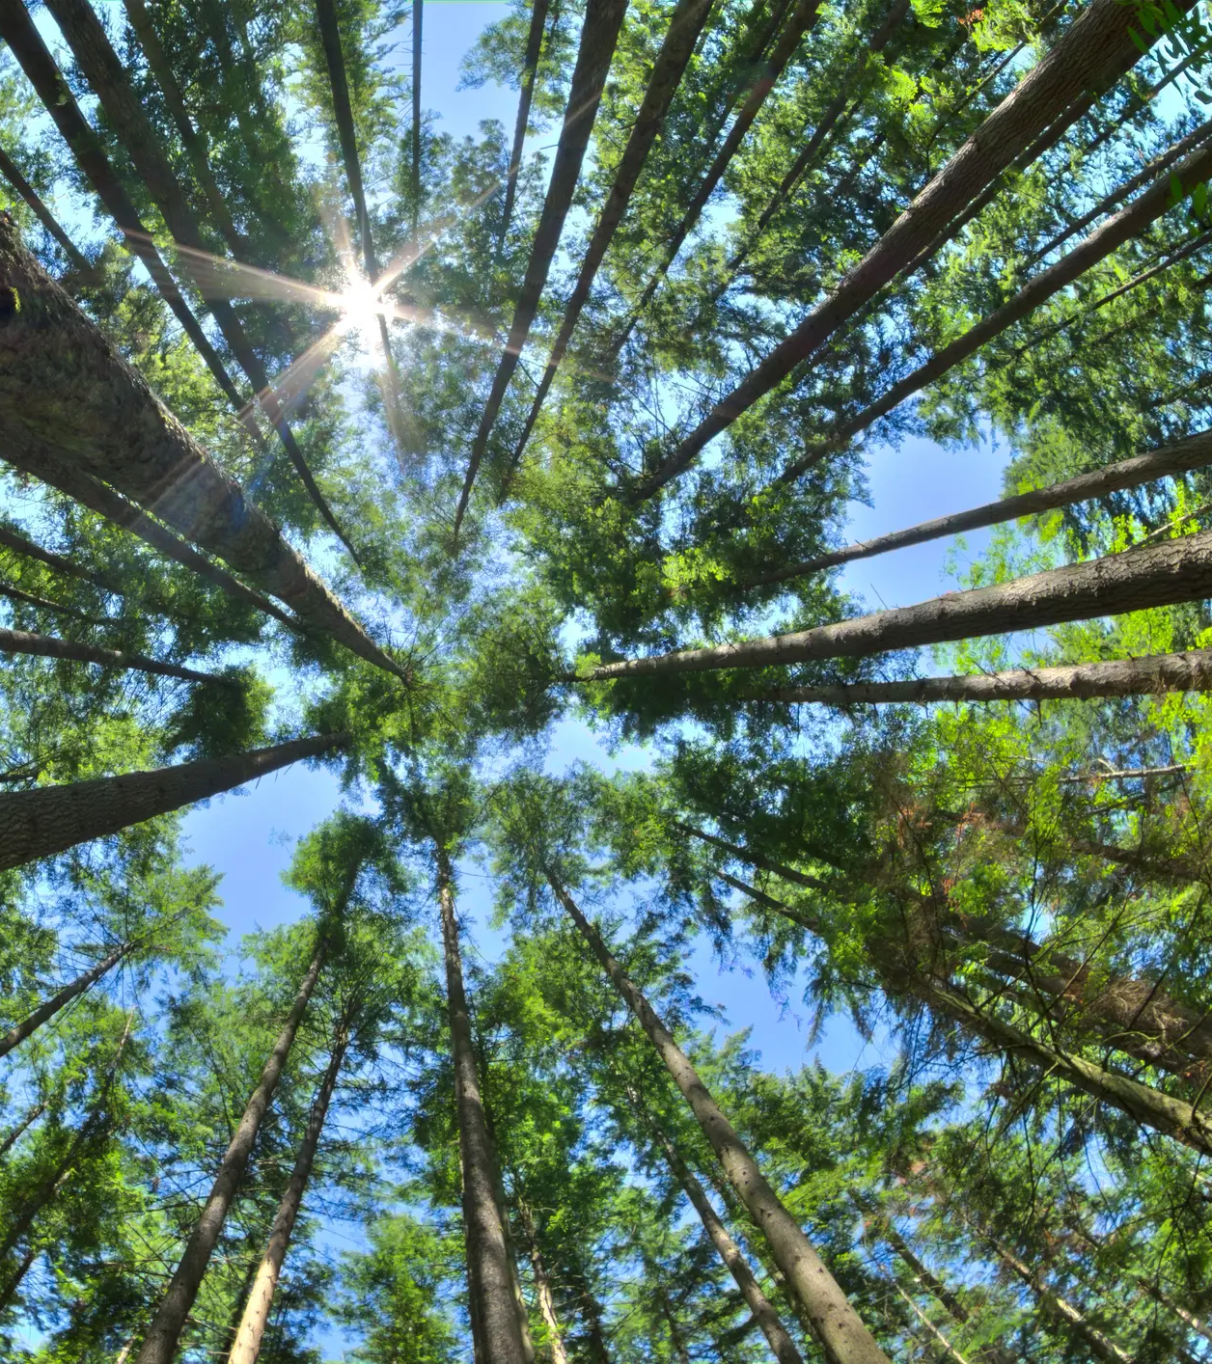
DATA SETS
A data set based on weather observations from 18 different weather stations across Europe, which contain data ranging from the late 1800s to 2022. The records were made almost every day with values such as temperature, wind speed, snow, global radiation, and more.
The data was collected by the European Climate Assessment & Data Set project.
Weather Data Set Link
Pleasant Data Set Link

Slide 5

DATA BIAS & ACCURACY
BIAS
Data Collection: The historical weather data comes from 18 different stations across Europe, but it may not equally represent all regions.
Location Bias: Since the data is centered on Europe and the Mediterranean, the predictions may not be applicable to other regions—such as Brazil or Canada—because they have different climate systems.
Human Bias: Older measurement instruments were less precise, making historical data less reliable.
Sampling Bias: Specific selection of stations can skew results, missing broader climate patterns across Europe.
ACCURACY
The accuracy of machine learning models depends on the algorithms and optimization technique applied.

Slide 6
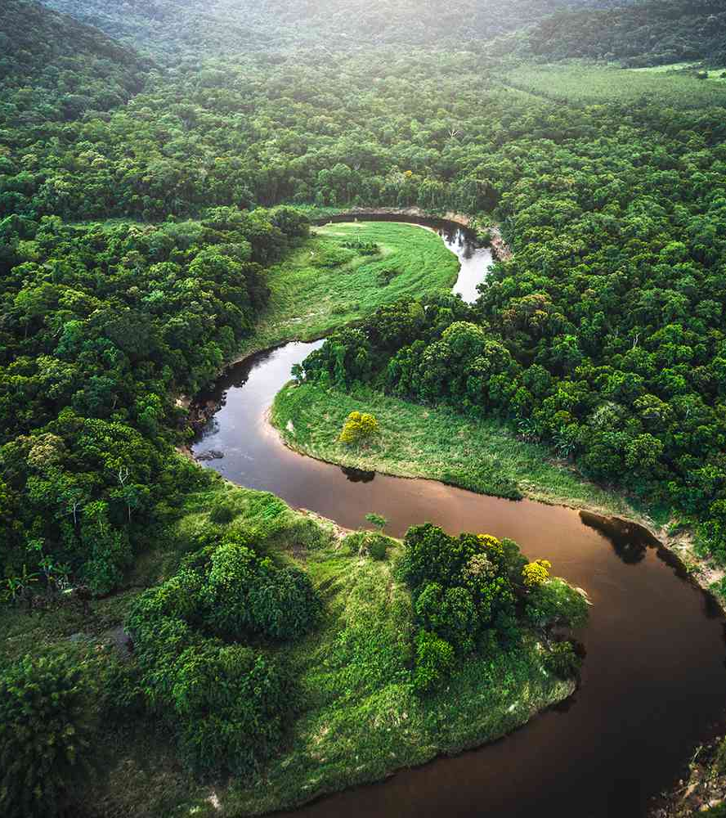
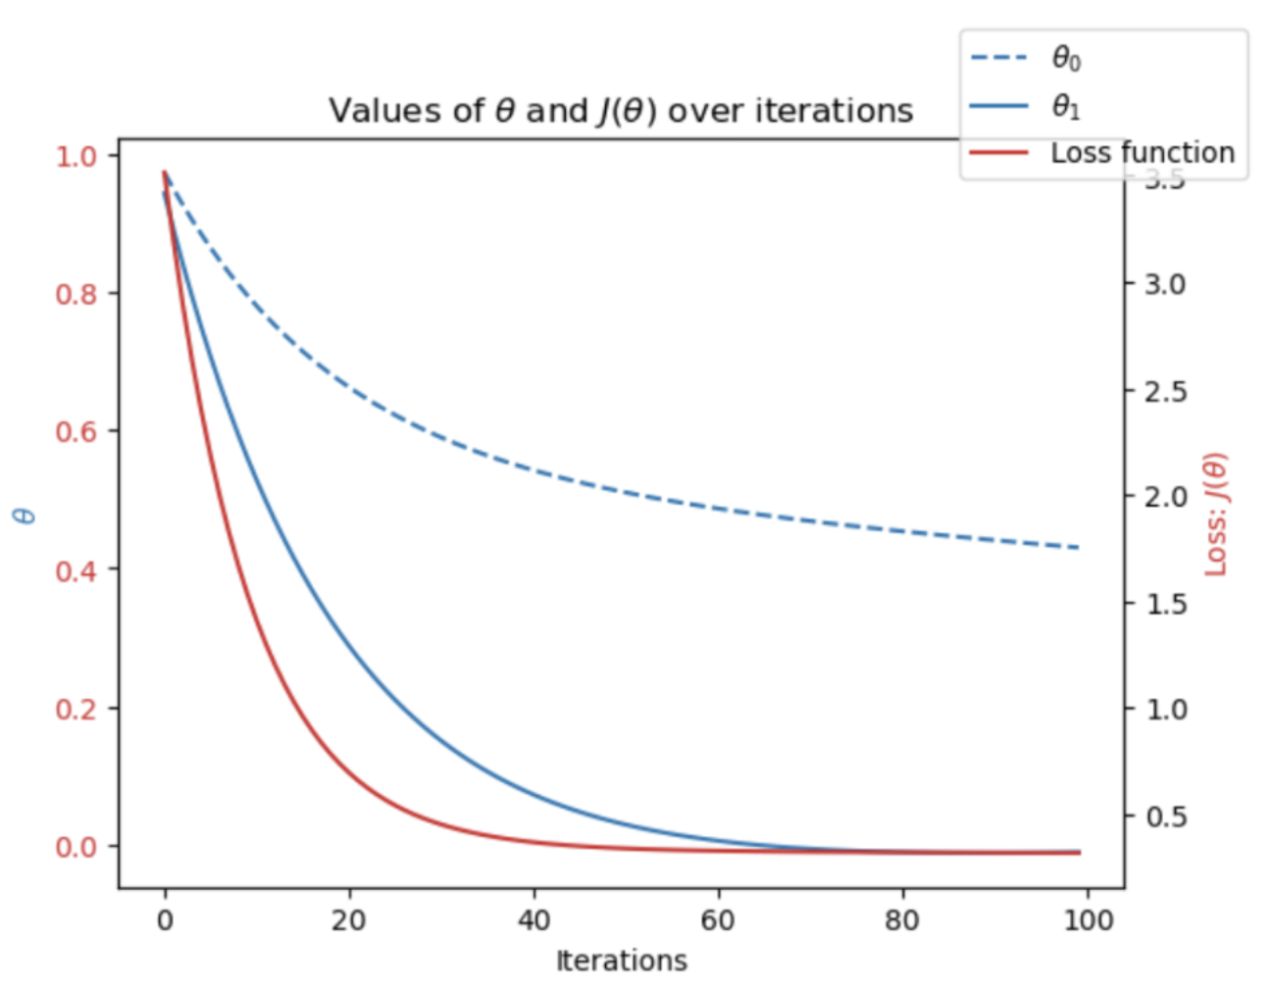
DATA OPTIMIZATION
The data was optimized to find the minimum error, through number of iterations, as well as the number of steps (alpha), which varied as the case through Gradient Descent.
It can be used in both linear and non-linear models.
Iterative optimization was able to minimize the loss function to nearly zero, after adjusting the theta0 and theta1, as well as the number of iterations and alpha.

Slide 7
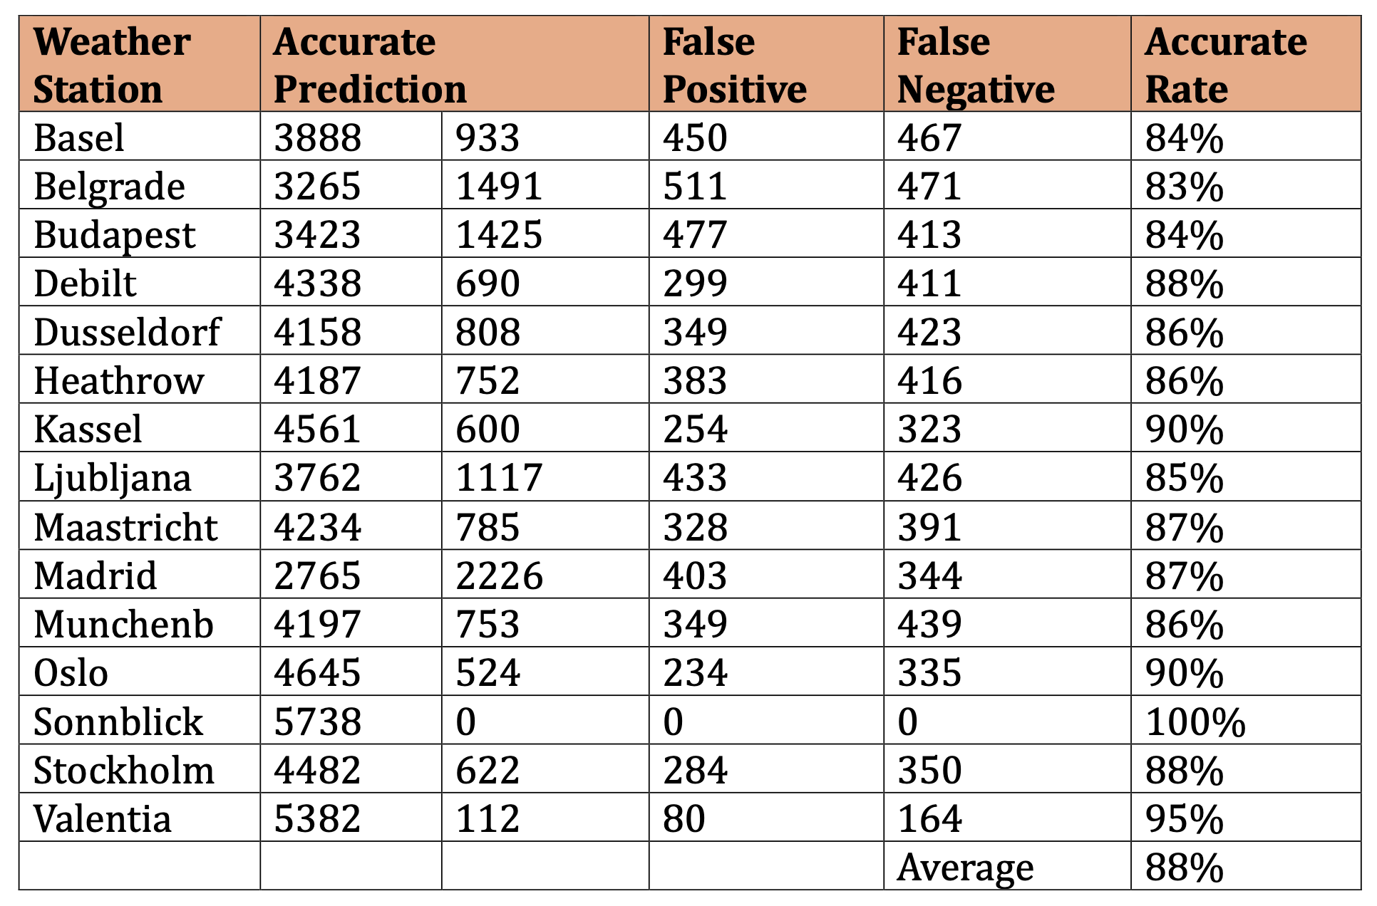
METHOD 1. K-NEAREST NEIGHBOR
The k-nearest neighbors (KNN) algorithm makes predictions by measuring the distance between new data points and nearby data points, or neighbors, then groups the new data with nearby data points based on the number of neighbors in each group.
Best Accuracy: Sonnblick (100%) had perfect accuracy, with zero false positives and false negatives. Valentia (95%), Oslo (90%), and Kassel (90%) also showed very high accuracy. Belgrade (83%) had the lowest accuracy, indicating possible challenges in prediction accuracy for this station.
Using a k-range value of 3, the model was able to predict pleasant weather days with an average accuracy of 88%.
To improve forecasting accuracy, the model requires training on diverse datasets, better handling of varied weather patterns, and rigorous cross-validation, enhancing adaptability for broader, reliable, and practical weather predictions.

Slide 8
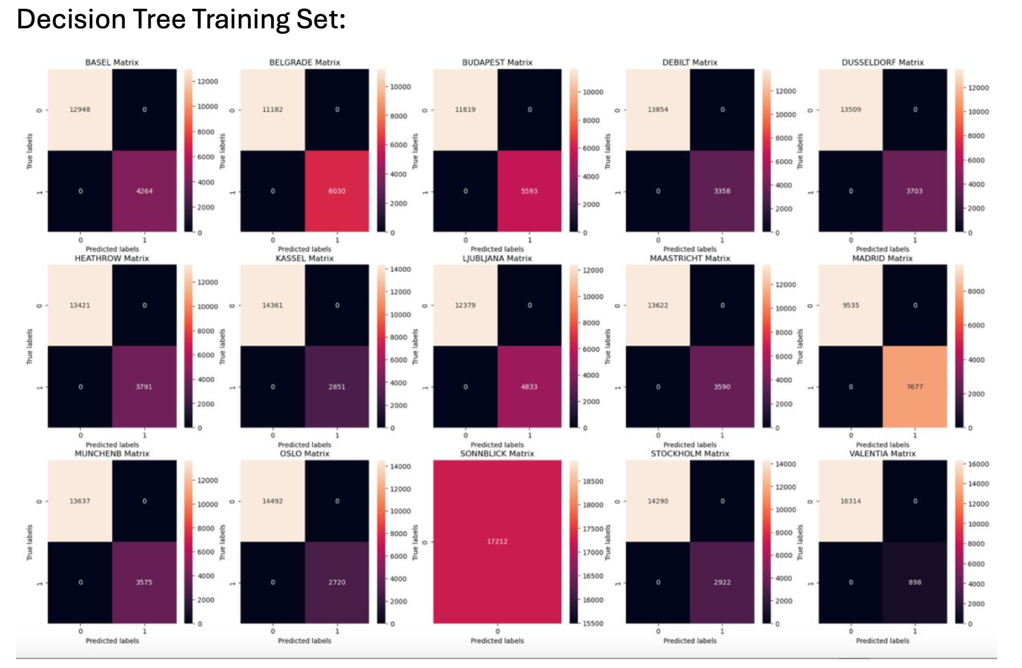
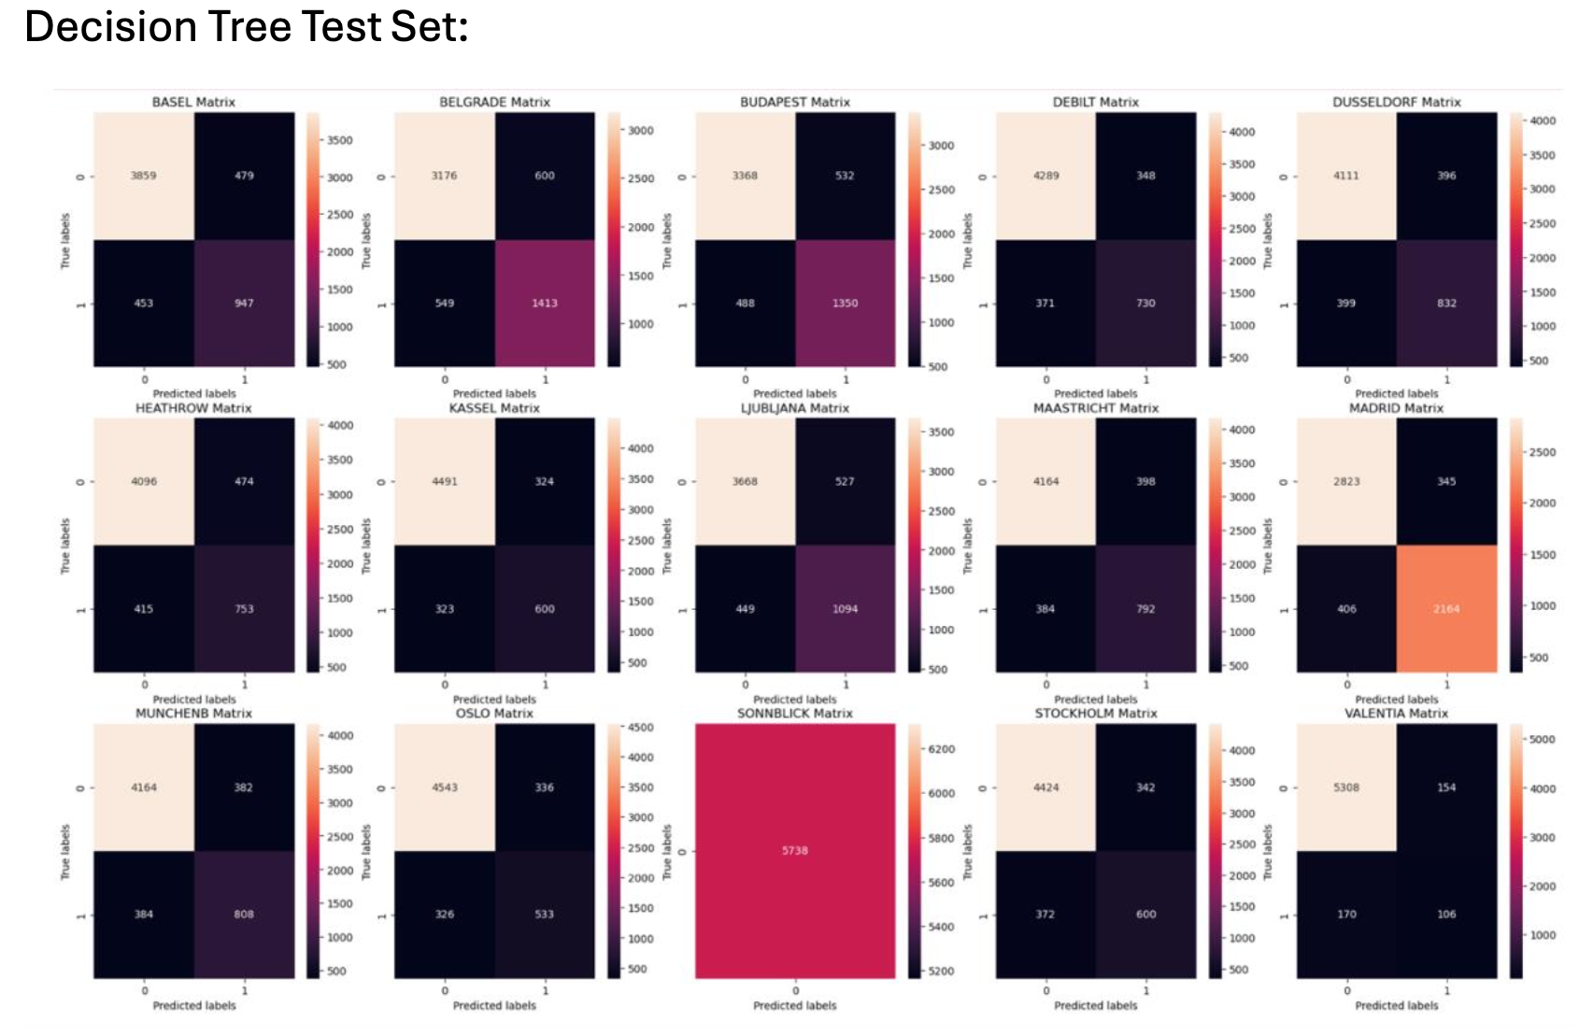
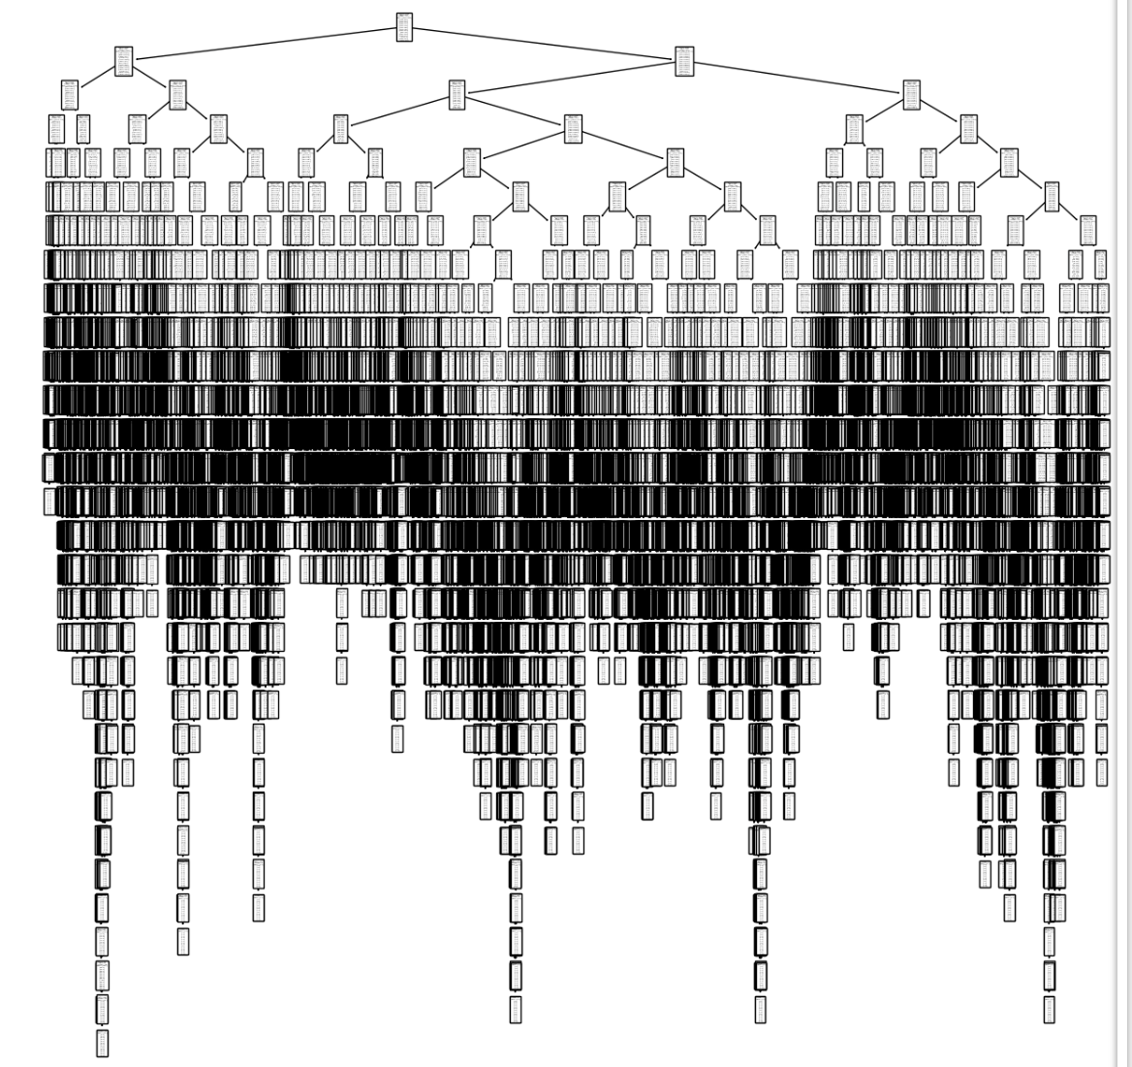
METHOD 2: DECISION TREE
The decision tree model currently illustrates poor accuracy, with only 46% on the training data and 47% on the test data.
The decision tree algorithm breaks down the classification process into a series of "yes" or "no" questions based on the features of the data. Starting from the root node, the algorithm splits the data at each branch based on the most relevant feature, continuously refining the classification.
The decision tree is very complex with too many branches which can lead to a model being too
difficult to interpret. The tree is also very large, which can take a long time to train.

Slide 9
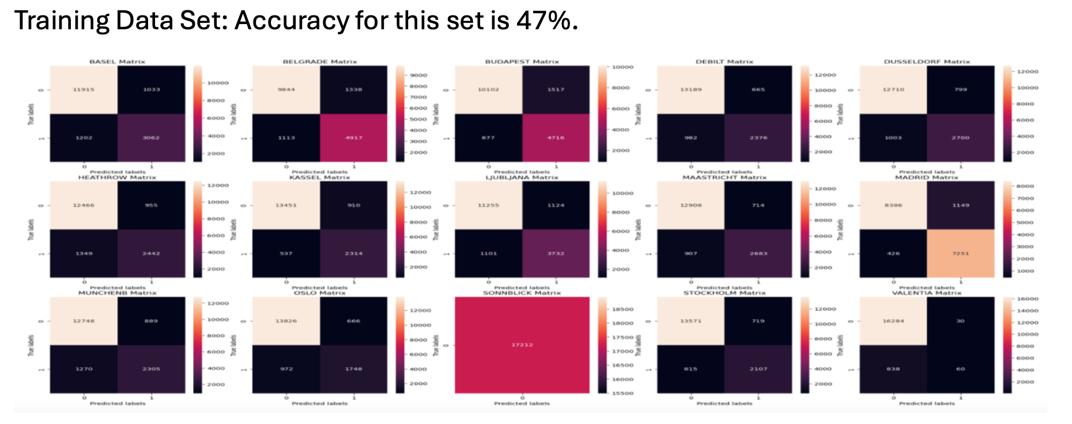
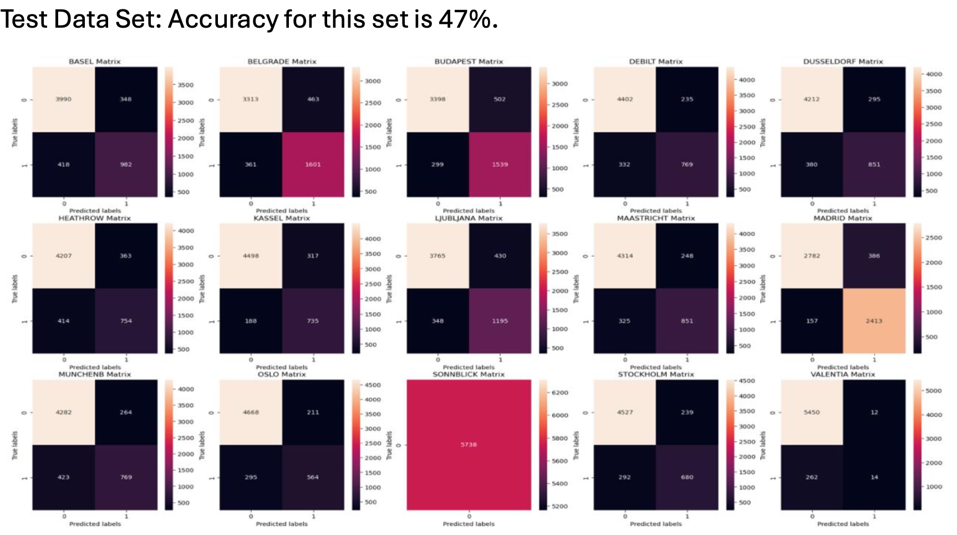
METHOD 3: ARTIFICAL NEURAL NETWORK (Scenario 1)
Artificial Neural Networks (ANNs) make predictions by processing data through a set of layers.
Upper left = accurate unpleasant, Upper right = inaccurate unpleasant.
Bottom left = inaccurate pleasant, Bottom right = accurate pleasant.

Slide 10
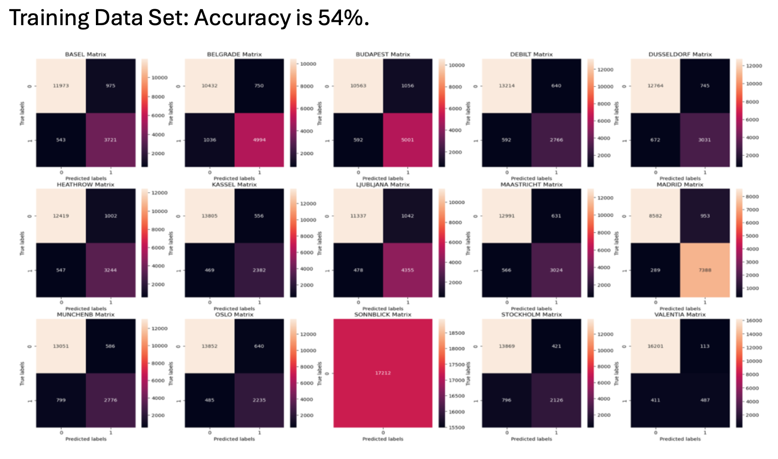
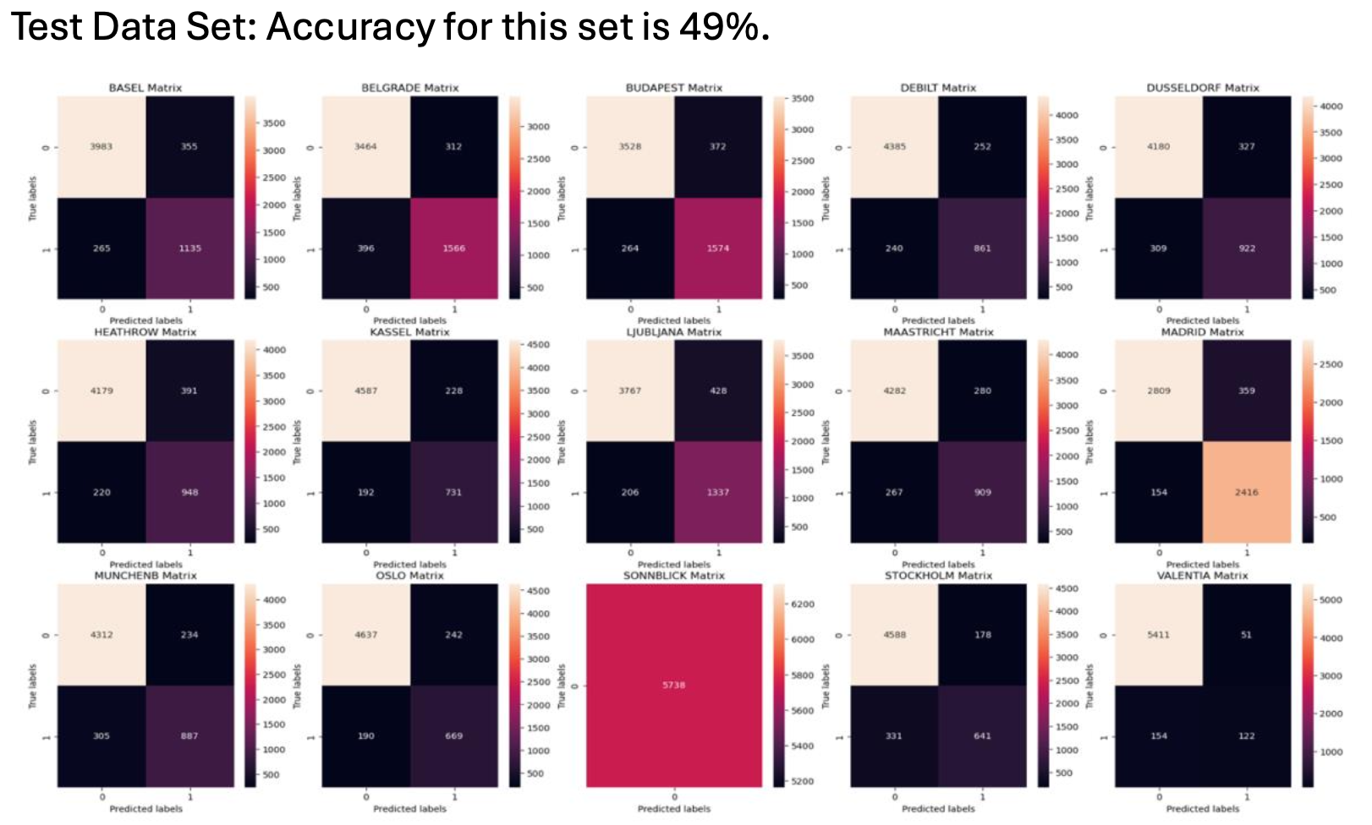
METHOD 3: ARTIFICAL NEURAL NETWORK (Scenario 2)

Slide 11
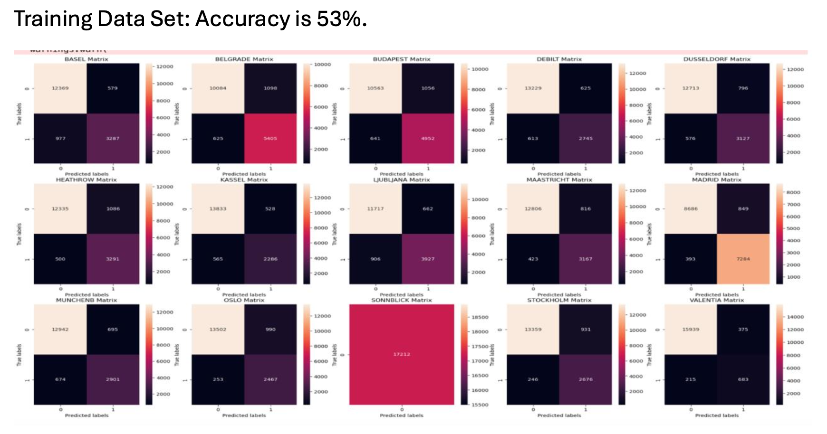
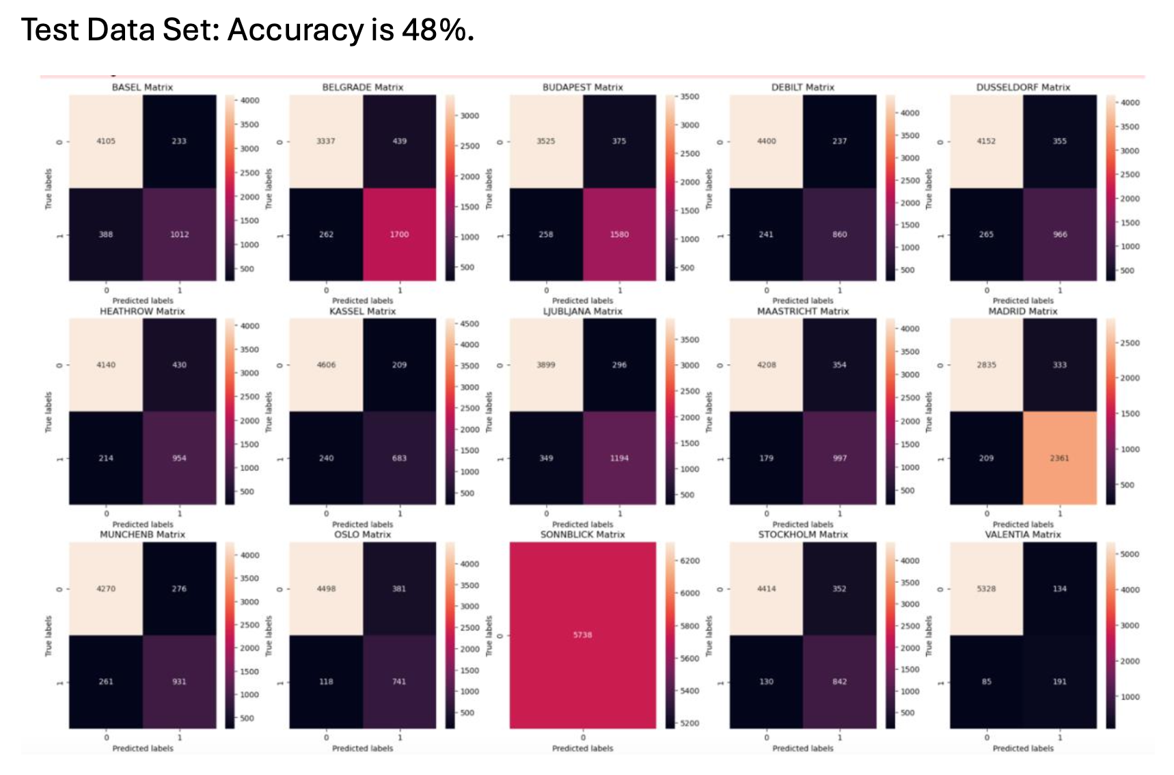
METHOD 3: ARTIFICAL NEURAL NETWORK (Scenario 3)

Slide 12

WHICH ALGORITHM IS BEST?
Based on model accuracy, K-Nearest Neighbors (KNN) is the most effective algorithm for ClimateWins to provide accurate predictions of good picnic weather since it effectively identifies patterns and makes reliable predictions.
On the other hand, The decision tree model is too complex to interpret. The ANN model is more powerful and better suited for complex tasks.

Slide 13
CONCLUSION & NEXT STEPS
The KNN algorithm predicted the data the best, with an average accuracy of 88% on the test set.
The decision tree still needs some adjustments (like pruning) to work better.
The ANN (artificial neural network) was not very reliable and only got about 46% accuracy, which is much lower than KNN.
Since the project isn’t finished yet, KNN is the best choice for now, because it did the best job at predicting the climate temperature.
Additionally, Keep testing both supervised and unsupervised algorithms after better optimizing them.
Try to improve the decision tree even more by pruning it further to increase accuracy.
In the end, combine supervised and unsupervised methods to build a more complete climate model — one that can predict both specific weather events and long-term climate trends.

Slide 14



GILLAMRIT03@OUTLOOK.COM
HTTPS://GITHUB.COM/GILLAMRIT92/CLIMATEWINS

